Slide 1
Key Stretching Algorithms

Slide 2
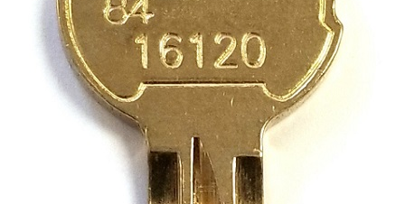
Strengthen weak keys
Weak keys are weak
On their own, they’re not secure
Make a weak key stronger by rehashing
Hash a password then hash that hash then hash that hash Rinse and repeat…
Brute force attacks would require reversing each hash
Hacker will have to work hard even though key is small
Key stretching

Slide 3

Key Stretching Libraries
Library = block of code to be reused in other programs
Offloads work of having to code complex algorithms
Makes your job easier to just use what is already available

Slide 4
bcrypt Library
Generates hashes from passwords
Written by Niels Provos and David Mazieres, 1999
Based on Blowfish cipher to perform multiple rounds of hashing (iterations)
Takes a salt to prevent rainbow table attacks
Creates 184 bit digest (hash output)
Used by many Linux distributions for password hashing
/etc/shadow file is hashed using bcrypt library

Slide 5
PBKDF2 Library
Password-Based Key Derivation Function 2
Part of RSA Public Key Cryptography Standards (PKCS #5, RFC 2898)
Used in Kerberos, Apple iOS, LastPass password manager
Number of times it rehashes, known as iteration
Number of iterations goes up as computing power grows that might try to brute force it
Takes a salt to prevent rainbow table attacks
Variable length digest (hash output)

